Slide 1
Introduction to Python
Akshita Sharma

Slide 2

Agenda
What is Python…?
Important features of Python
History of Python
Scope of Python & Why do people use Python?
Installing Python IDE
Who uses python today
What can I do with python
Running Python
A Sample Code (Python code execution)

Slide 3
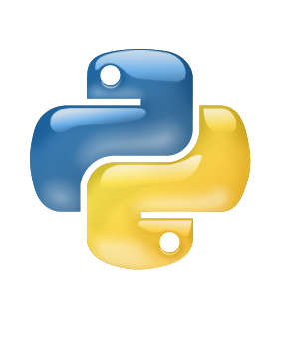

What Is python ?
Python is a general purpose programming language that is often applied in scripting roles. So, Python is programming language as well as scripting language. Python is also called as Interpreted language
This Photo by Unknown author is licensed under CC BY-NC.

Slide 4
Important features of Python:
Built­-in high level data types
Multiple levels of organizational structure
Object­ oriented
Extensions in C and C++
Dynamic
Highly structured
Varieties of Python

Slide 5
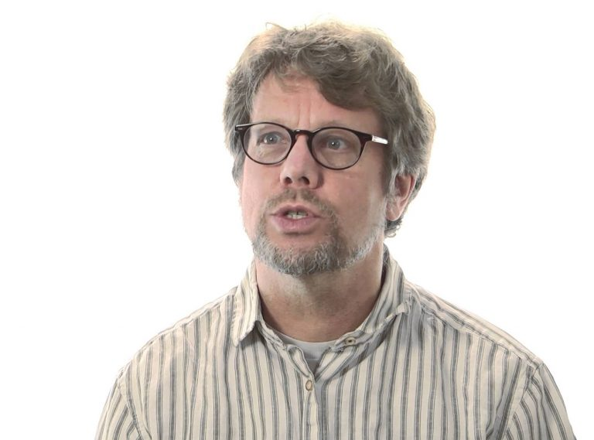
History of Python
Invented in the Netherlands, early 90s by Guido van Rossum Python was conceived in the late 1980s and its implementation was started in December 1989
Guido Van Rossum is fan of ‘Monty Python’s Flying Circus’, this is a famous TV show in Netherlands Named after Monty Python
Open sourced from the beginning

Slide 6
Scope of Python & Why do people use Python?
Science
System Administration
Web Application Development
Testing scripts
The following primary factors cited by Python users seem to be these
Python is object-oriented
Indentation
It's free (open source)
It's powerful , portable , mixable
It's easy to use and learn

Slide 7
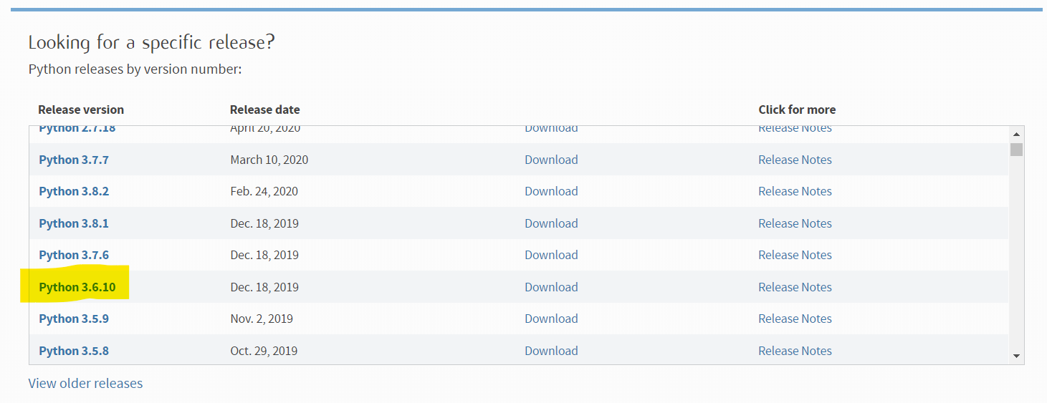
Installing python
Python is pre-installed on most Unix systems, including Linux and MAC OS X
But for in Windows Operating Systems , user can download from the https://www.python.org/downloads/ - from the above link
Download latest version of python IDE and install, recent version is 3.4.1 but most of them uses version 2.7.7 only

Slide 8
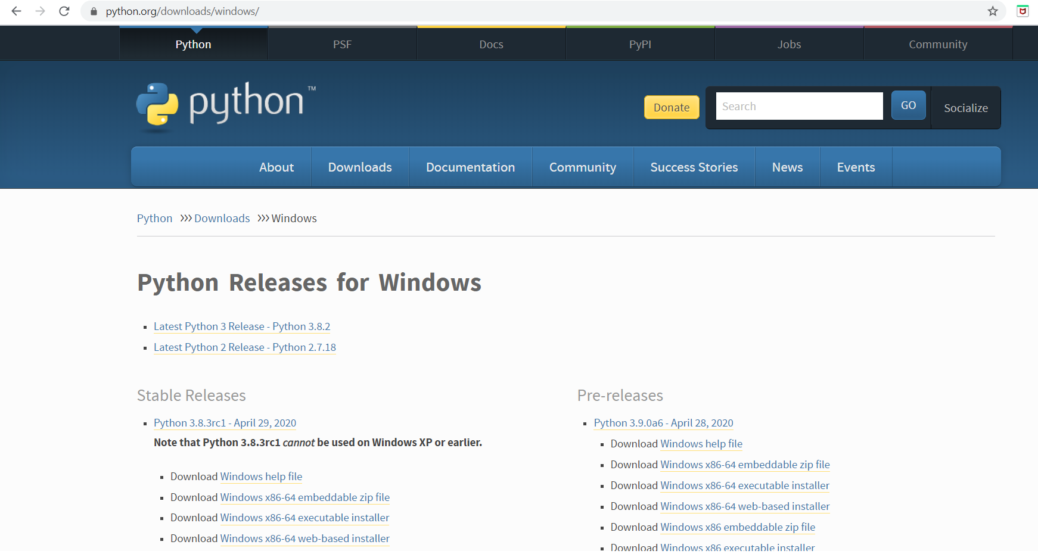

Slide 9
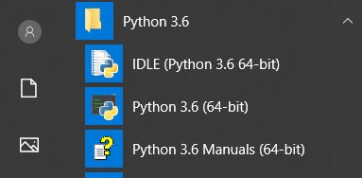

Slide 10
Who uses python today…
Python is being applied in real revenue-generating products by real companies.
For instance: Google makes extensive use of Python in its web search system, and employs Python’s creator.
Intel, Cisco, Hewlett-Packard, Seagate, Qualcomm, and IBM use Python for hardware testing.
ESRI uses Python as an end-user customization tool for its popular GIS mapping products.
The YouTube video sharing service is largely written in Python

Slide 11
What can I do with Python?
System programming
Graphical User Interface
Programming
Internet Scripting
Component Integration
Database Programming
Gaming, Images, XML , Robot and more

Slide 12

A Sample Code
x = 34 - 23 # A comment.
y = “Hello” # Another one.
z = 3.45 if z == 3.45 or y == “Hello”:
x = x + 1 y = y + “ World” # String concat.
print x
print y

Slide 13
Enough to understand the code
Indentation
First assignment to a variable creates it
Assignment is = and comparison is ==
For numbers + - * / % are as expected
Logical operators are words (and, or, not) not symbols
The basic printing command is print

Slide 14
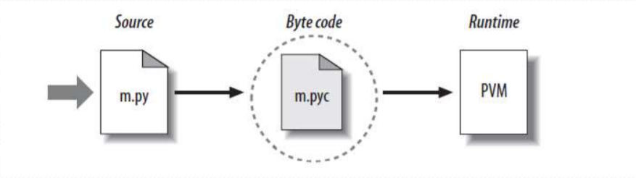
Python Code Execution

Slide 15
Running Python
>>> print 'Hello world'
>>> x = [0,1,2]
>>> x
[0,1,2]
>>> 2+3
5

